Slide 1

MALWARE DETECTION USING MACHINE LEARNING ALGORITHMS

Slide 2
TEAM MEMBERS
Basheer Ahmed M (21504643)
Harish R (21504647)
Mega Prasanth B(21591298)
Mohamed Ashik S (21504652)
Sathya M (21591302)
Srividhya K (21504664)

Slide 3
AGENDA
Abstract
Introduction
Existing System
Disadvantages
Proposed System
System requirements
Software Description
Project Description
Modules
Conclusion

Slide 4
ABSTRACT
Malware is one of the major security concerns for the Windows platform.
Malware is a type of computer software that disturbs the availability of computer services.
The traditional detection systems such as the intrusion detection system, anti-virus software, etc. cannot detect unseen malware due to the use of signature-based methods.

Slide 5
So, there is a need to accurately detect such kind of malware in the Windows (or) Android environment
In our project, a Machine Learning based malware detection system is introduced .
Which is used to find whether portable executable file is malicious or clean.

Slide 6
INTRODUCTION
Malware is a general term for any type of unwanted software that does mischief or permanent damage to your computer
Malware is created by people to intentionally do mischief or damage to your computer
Malware is a malicious software that gets installed in your device and performs unwanted tasks

Slide 7

Mainly designed to transmit information about your web browsing habits to the third party

Slide 8
TYPES OF COMPUTER MALWARE
Spyware
Adware
Trojan
Worms
Rootkits
Bots

Slide 9
Spyware:
Spyware collects information about users’ activities without their knowledge.
This can include passwords, pins, payment information.
Adware:
Adware tracks a user’s surfing activity .
Although adware is similar to spyware, it does not install any software on a user’s computer.

Slide 10
Trojan:
A Trojan disguises itself as desirable code or software. Once downloaded by unsuspecting users.
The Trojan can take control of victim’s systems for malicious purposes.
Trojans may hide in games apps, or even software and phising mails.
Bot:
A bot is a software application that performs automated tasks on command.
They’re used for legitimate purposes.

Slide 11
EXISTING SYSTEM
Traditional security software or algorithms practices old-virus scanner for detecting faulty/malicious program/code, they uses “signature-based detection” to detect malware.
But with malware that have become polymorphic and metamorphic.
the traditional used detection method i.e, signature-based detection method by antivirus are no longer effective.

Slide 12
DISADVANTAGE
They can only deal with non attacks
They are unable to detect novel attacks.
They suffer from false alarms.
They have to be programmed again for every new pattern to be detected.

Slide 13
PROPOSED SYSTEM
In our project we are focusing on malware discovery. Our focus is to distinguish “malware in the system”.
Two commonly used malware detection are
1) static analysis
2) dynamic analysis.
Aimed for efficient and effective recognition.

Slide 14
For building a learning algorithm, features are haul out from the categories will experience arrangement with using supervised learning classification type
To get outcome of the machine learning based model is to test different dataset with tag to produce a graph which specify the rate of detection and false positive rate.

Slide 15
To find the best outcome, repeat the process using many other classifications such as naïve bayes classifier,svm,knn,random forest and create learning model to test on the same dataset.
The best outcome is gained when the graph has maximum detection rate and lowest false positive rate

Slide 16
SYSTEM REQUIREMENTS
Hardware required:
1) any intel core I series processor
2) os windows 10 or above
Software required:
1) Anaconda (jupiter)
2) Python (program language)

Slide 17
SOFTWARE DESCRIPTION
Anaconda is a Python distribution (prebuilt and preconfigured collection of packages) that is commonly used for data science.
The Anaconda distribution includes the Conda package manager in addition to the preconfigured Python packages and other tools.
Anaconda Navigator is a GUI tool that is included in the Anaconda distribution and makes it easy to configure, install, and launch tools such as Jupyter Notebook.

Slide 18
MODULES
There are three modules in our project
Training phase
Detection phase
Testing phase
MODULE DESCRIPTION :
Training Phase:
In training phase the data set are analysed and features are extracted, from the features extracted model is trained with different dataset. For training we will use the machine learning algorithm

Slide 19
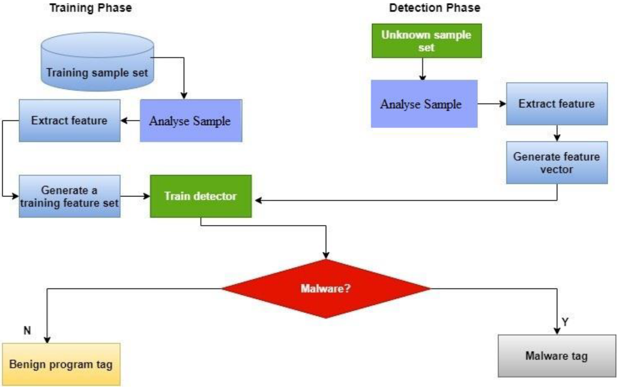
Testing Phase:
In testing phase the model is test and we can find malware with different test data set samples.

Slide 20
Detection Phase:
In detection phase by using unknow data samples or sets we will analysis the model features and generate the feature vectors.

Slide 21
Conclusion
In this research, we have proposed a malware detection module based on
advanced data mining and machine learning. While such a method may not be
suitable for home users, being very processor heavy, this can be implemented at
enterprise gateway level to act as a central antivirus engine to supplement
antiviruses present on end user computers. This will not only easily detect
known viruses, but act as a knowledge that will detect newer forms of harmful
files. While a costly model requiring costly infrastructure, it can help in
protecting invaluable enterprise data from security threat.

Slide 22
THANK YOU

